Slide 1
Toward Practical Reinforcement Learning
Addressing Sample Efficiency, Interpretability, and Safety Concerns in RL.
Hao Sun, Feb. 2021.
The Chinese University of Hong Kong
sh018@ie.cuhk.edu.hk

Slide 2
Challenges in RL^{[1]} / and My Research Related
1. Batch-RL, learning with off-line data 2. Sample-efficient method for real-world systems 3. High-dimensional continuous control 4. Safety constraints that should never or at least rarely be violated 5. Partially observable, non-stationary or stochastic tasks 6. Reward functions that are unspecified, multi-objective, or risk-sensitive 7. Explainable or interpretable policy 8. Real-time inference 9. Large and/or unknown delays in the system
[1] Dulac-Arnold, Gabriel, Daniel Mankowitz, and Todd Hester. "Challenges of real-world reinforcement learning." In ICML’19.

Slide 3
Overview
PCHID: Goal Conditioned RL with Sparse Reward
ESPD: Improved PCHID
ZOSPI: Generalized Self-Supervised RL
NPSCO: Seeking Diverse Behaviors in RL
ET-MDP (preliminary): Efficient Safe-RL
DiCE: Ensemble Method for Large-Scale RL
TD-IC-INVASE (preliminary): Variable Selection in TD learning
Sample-Efficient RL
Constrained-RL
Interpretability

Slide 4
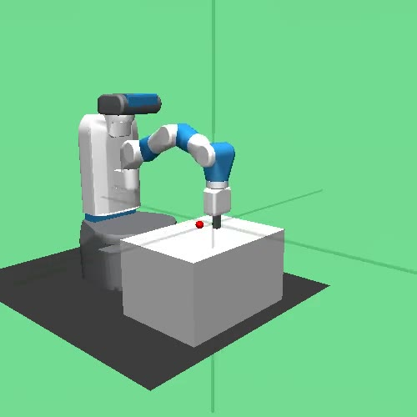

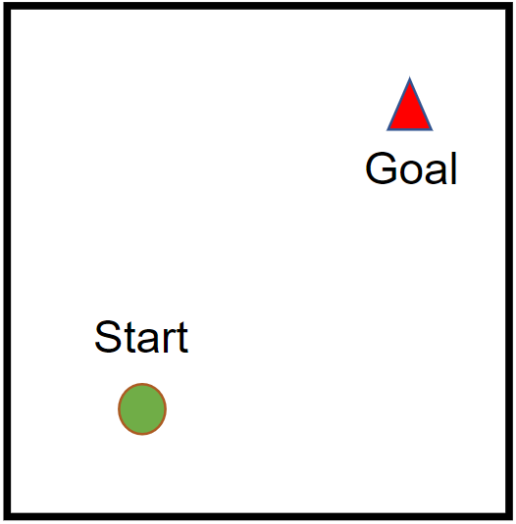
PCHID and ESPD
Problem Setting:
Solving Goal-Conditioned Reward Sparse Tasks with Self-Supervised Reinforcement Learning

Slide 5
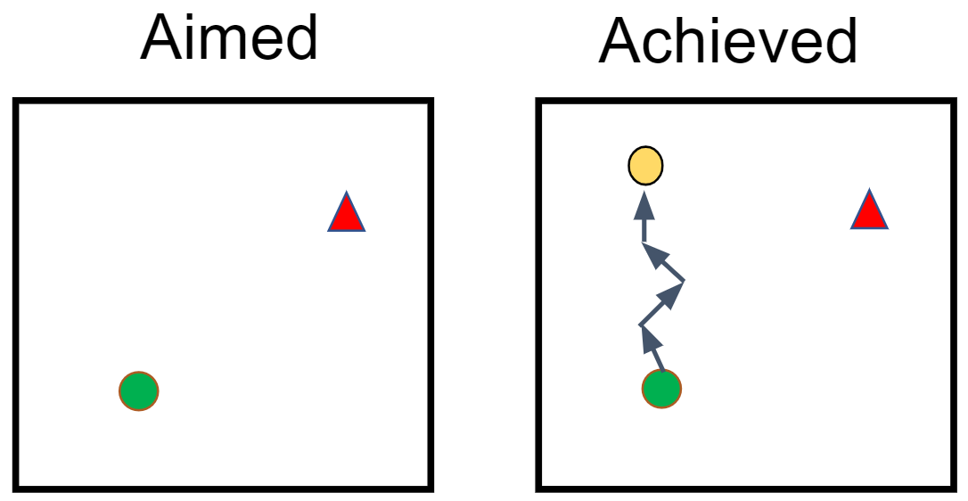
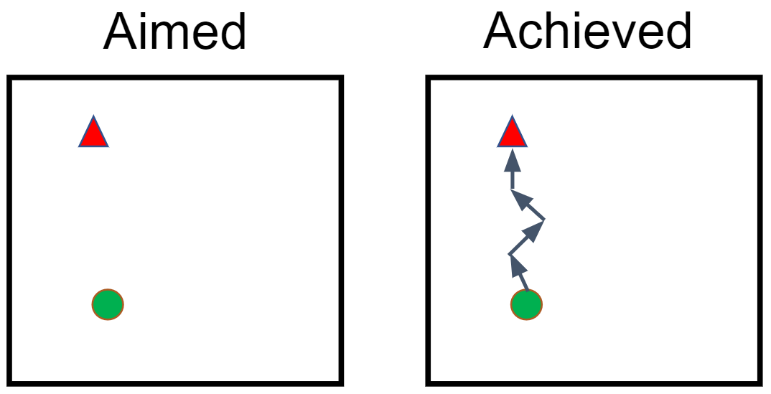
Inspirations from Human Learning
1. Learning from failures ^{[2]}
[2] Andrychowicz, Marcin, et al. "Hindsight experience replay." In NeurIPS’17

Slide 6
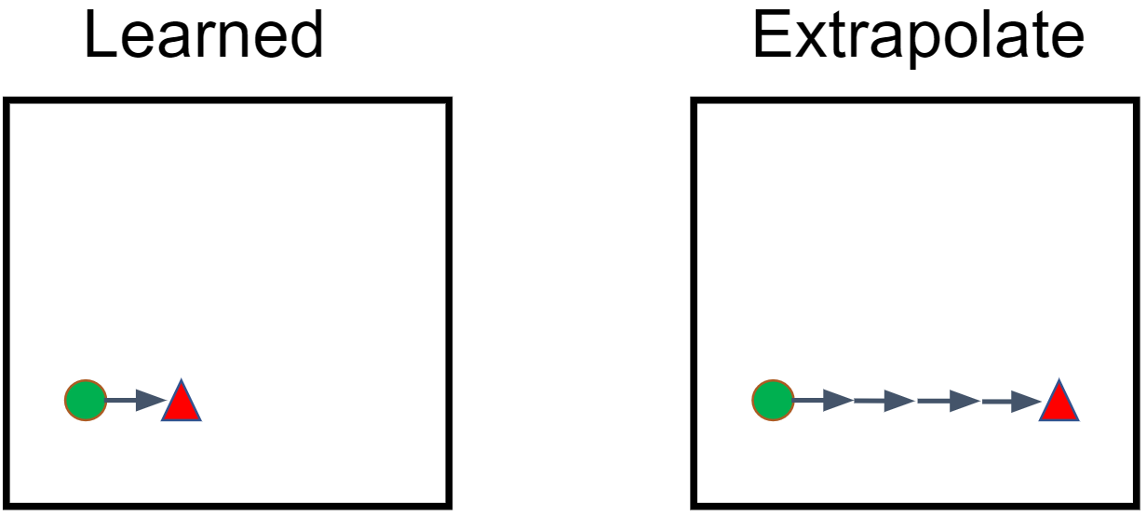
Inspirations from Human Learning
2. Extrapolate Success

Slide 7
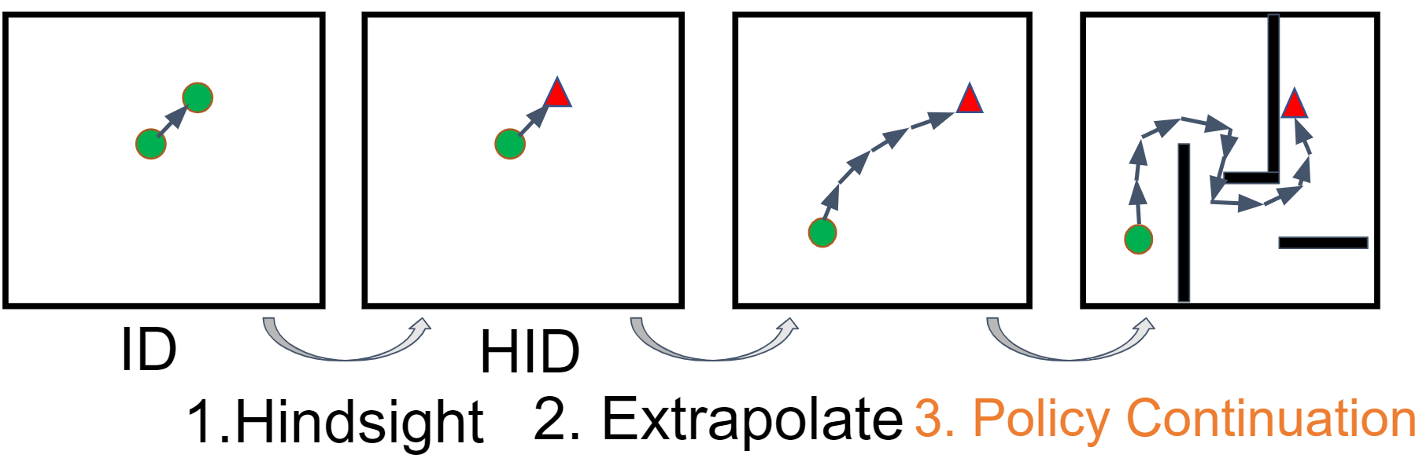
Policy Continuation with Hindsight Inverse Dynamics

Slide 8
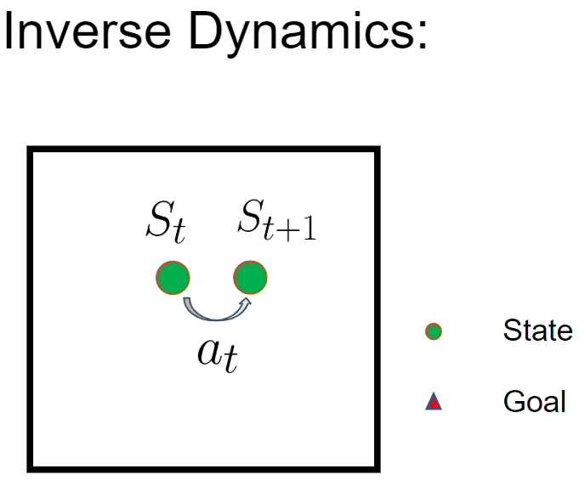
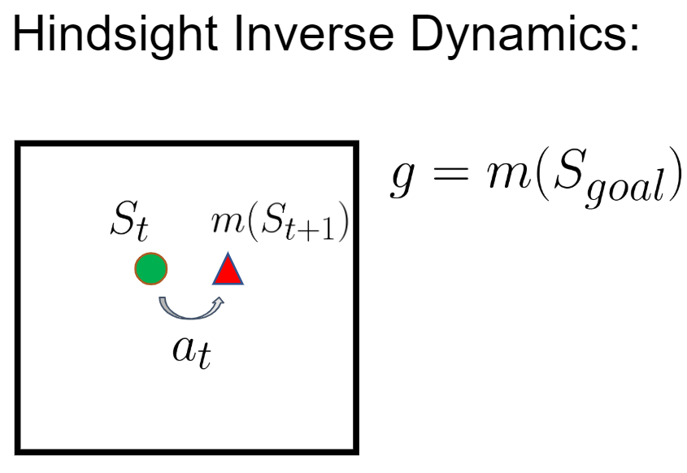
Equip Inverse Dynamics with Hindsight

Slide 9
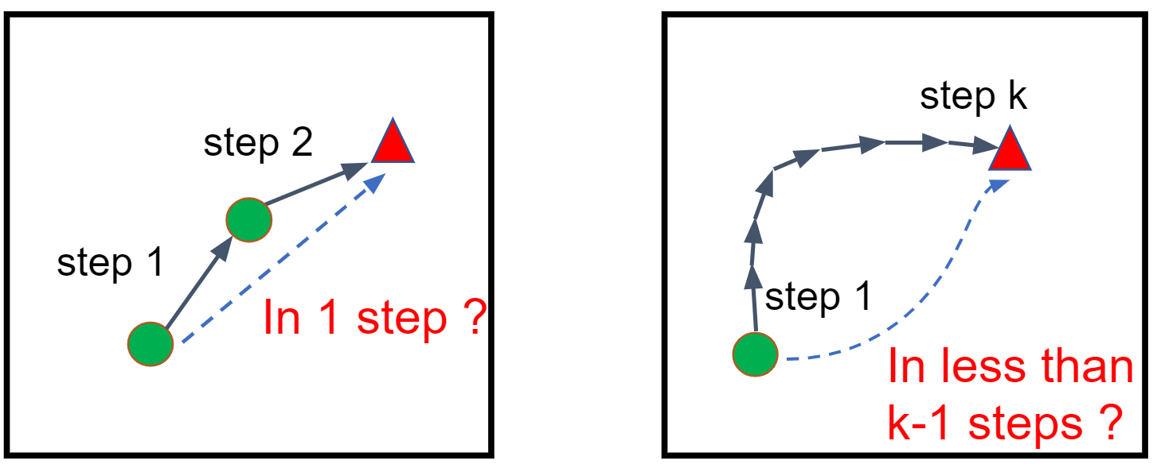
Policy Continuation by Recurrent Testing
While the 1-step HIDs are naturally optimal (we have 1-step optimal policy!), multi-step HIDs need to be filtered recursively.

Slide 10
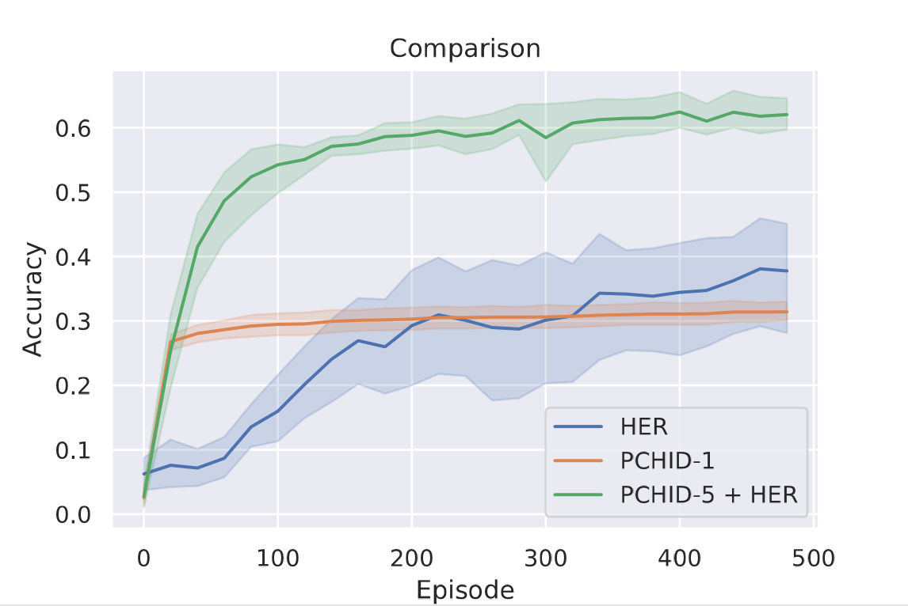
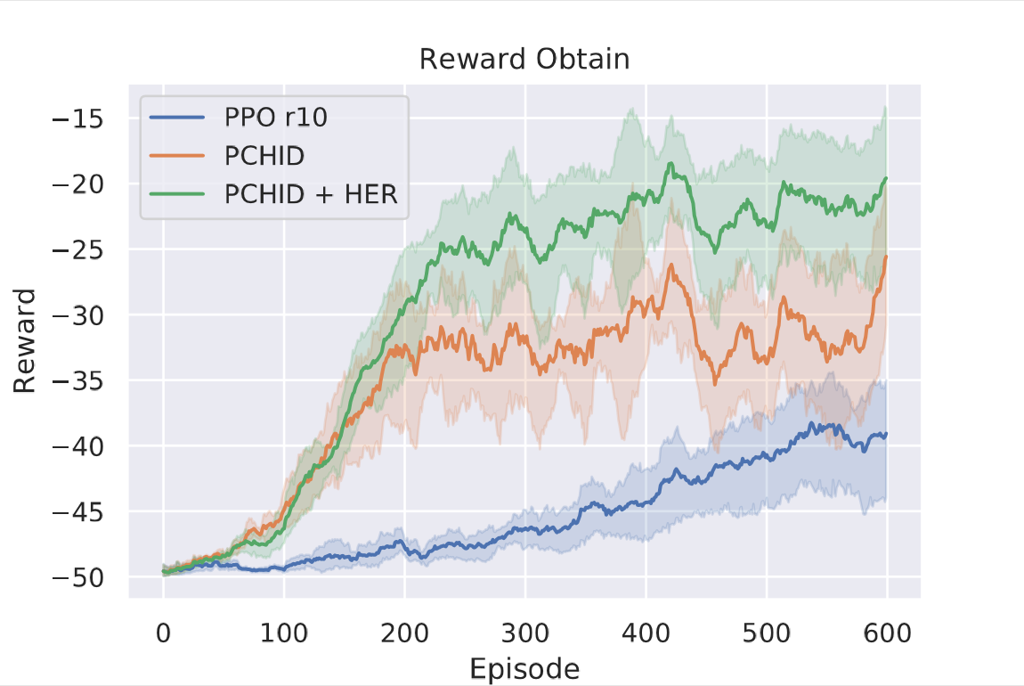
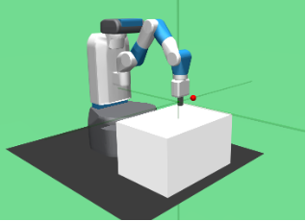
Experiments
Random Maze Navigation
Fetch-Reach

Slide 11
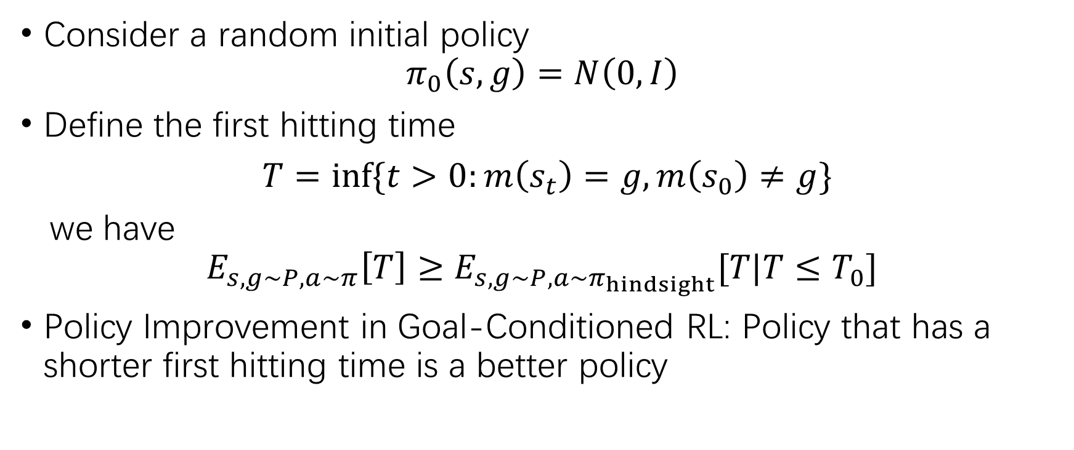
ESPD: PCHID without Explicit Curriculum
Consider a random initial policy $π_{0}\left(s,g\right)=N\left(0,I\right)$
Define the first hitting time
$T=inf\{t>0:m\left(s_{t}\right)=g,m\left(s_{0}\right)≠g\}$
we have $$E_{s,g∼P,a∼π}\left[T\right]≥E_{s,g∼P,a∼π_{hindsight}}[T|T≤T_{0}]$$
Policy Improvement in Goal-Conditioned RL: Policy that has a shorter first hitting time is a better policy

Slide 12
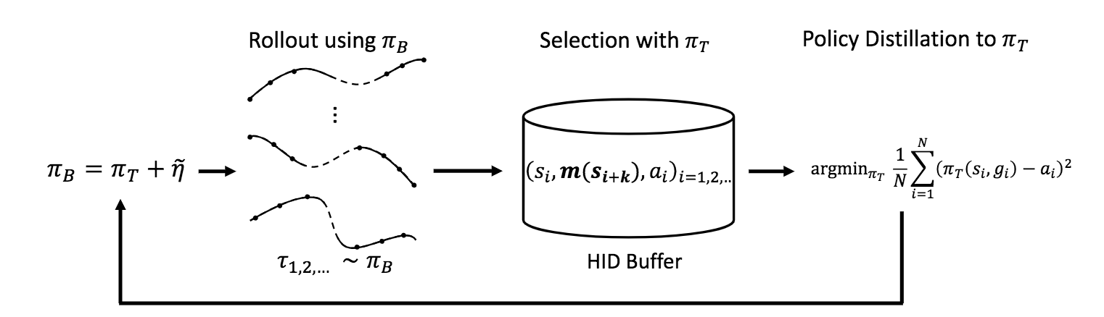
Evolutionary Stochastic Policy Distillation
Regard those trajectories with shorter FHT as coming from some oracle policies.
Use PD to optimize the policy.

Slide 13
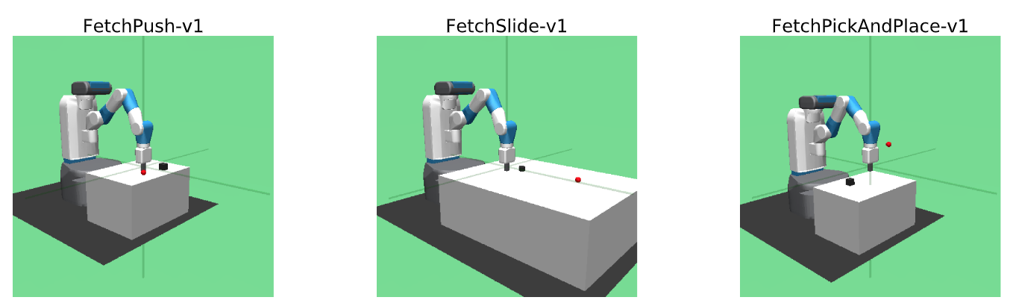
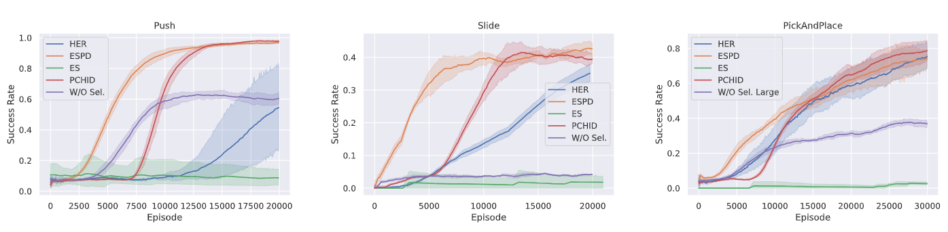
Comparison of ESPD and PCHID

Slide 14
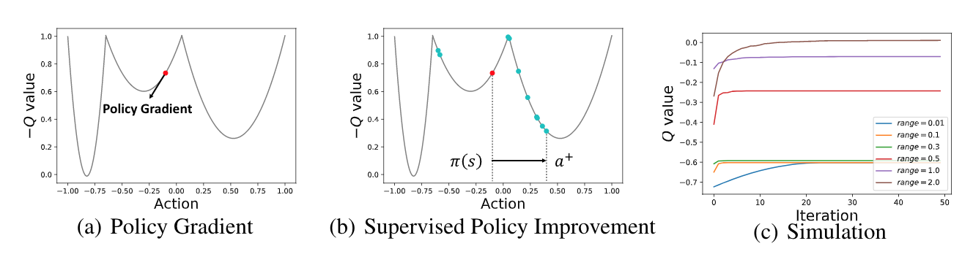
ZOSPI: Generalized Self-Supervised RL
Motivation: Local Exploitation Problem in RL^{[3]}
The basic idea: ESPD with Q-function
[3] Tessler, Chen, Guy Tennenholtz, and Shie Mannor. "Distributional policy optimization: An alternative approach for continuous control." In NeurIPS’19.

Slide 15
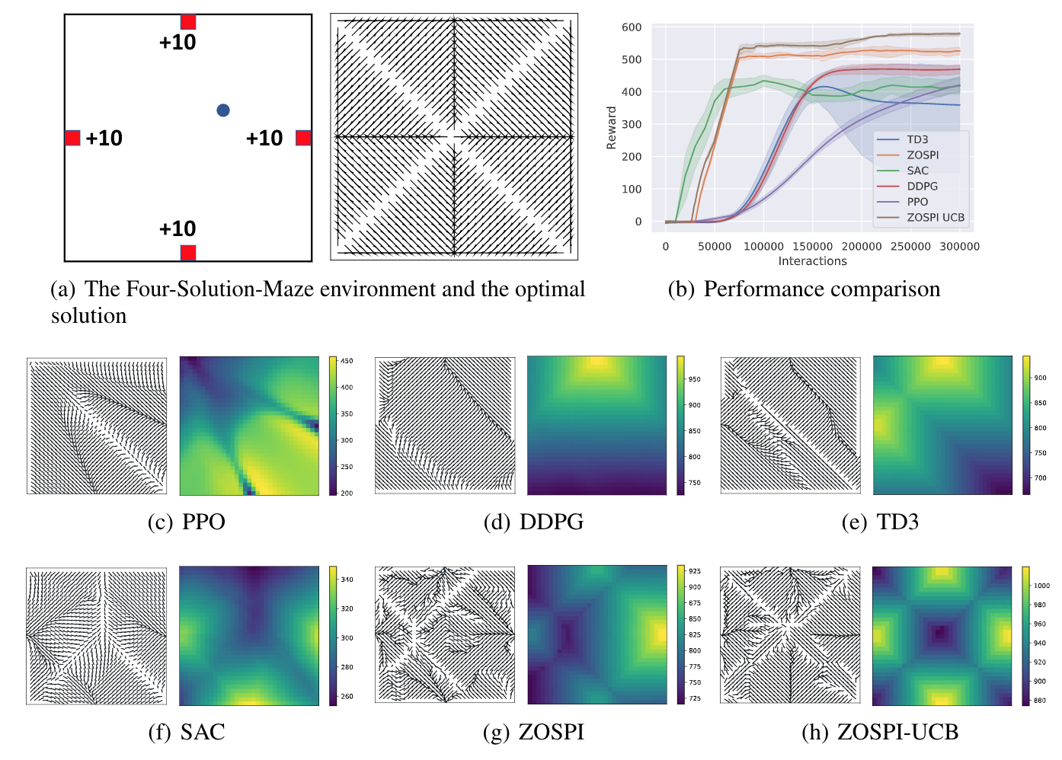
Illustration of Local Exploration Problem
We demonstrate the problem on a toy model called Four-Solution-Maze.
ZOSPI is the only method can find all four reward points.

Slide 16
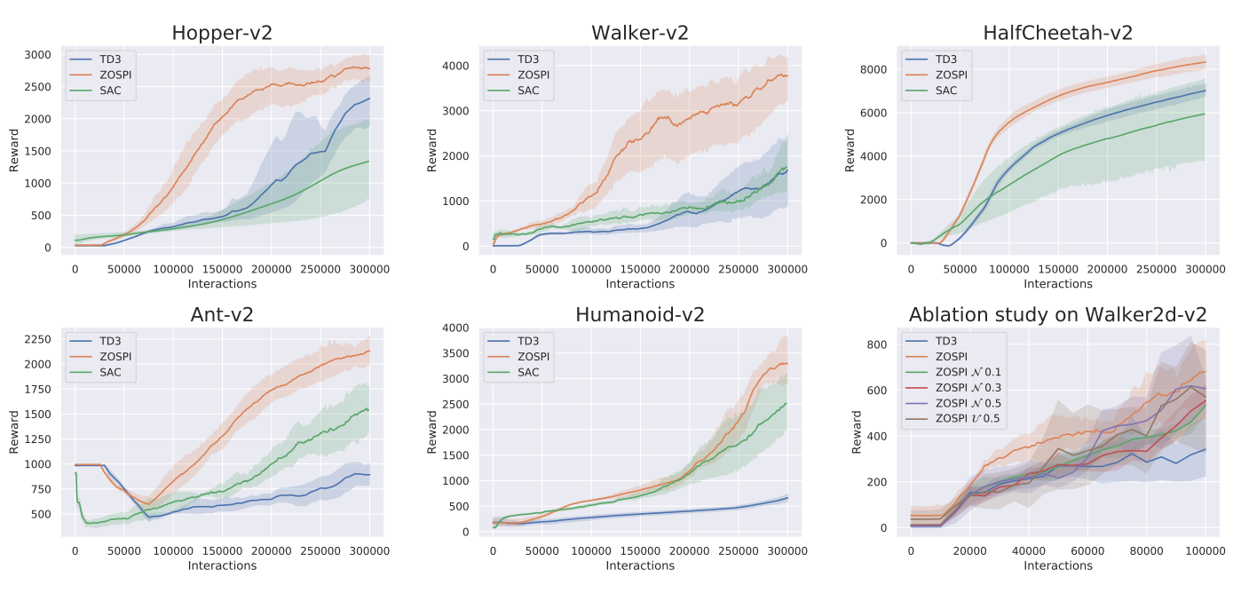
Experiments on MuJoCo Locomotion Tasks

Slide 17
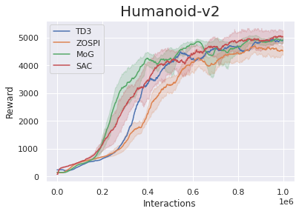
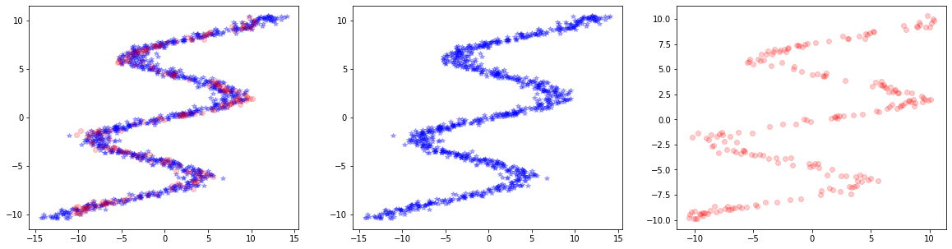
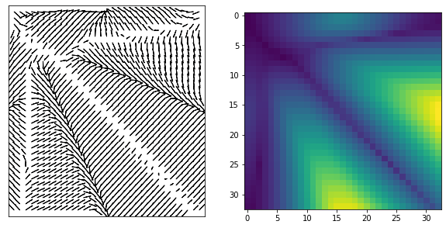
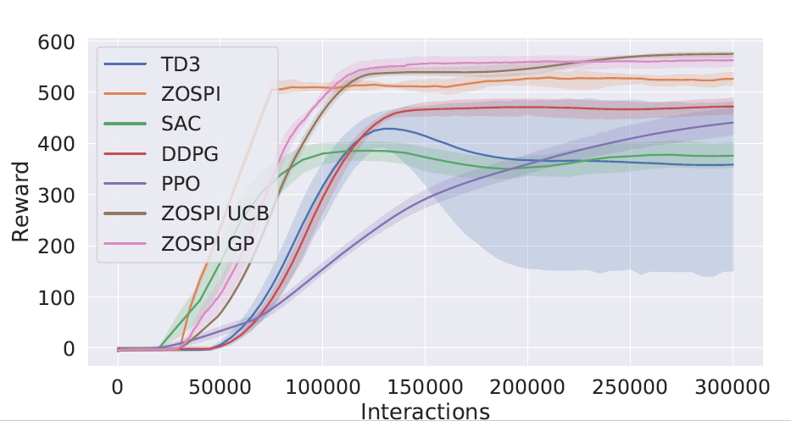
Extensions Based on ZOSPI
As ZOSPI is trained with supervised learning (regression)
It can learn with Gaussian Mixture Models. (e.g., Mixture Density Networks)
Non-parametric models can be used. (e.g., Gaussian Processes)

Slide 18
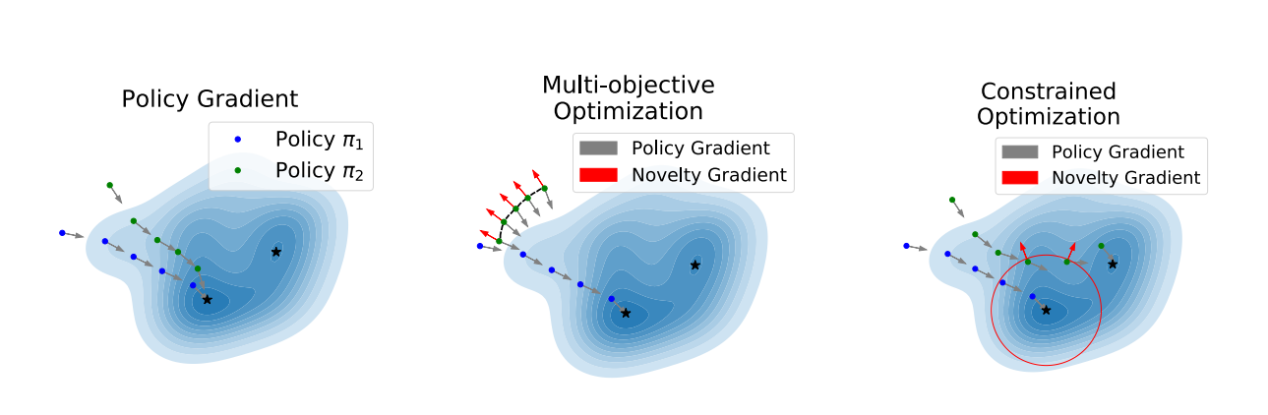
Diversity Seeking in Reinforcement Learning
In this project, we aim at solving RL tasks with diverse behavior, so that we can
Boost non-local exploration
Enable downstream tasks like policy ensemble
Generative models for RL: interpretable agents.
Problem Formulation: Constrained Optimization
Rather than previous multi-objective optimization for novel policy seeking

Slide 19
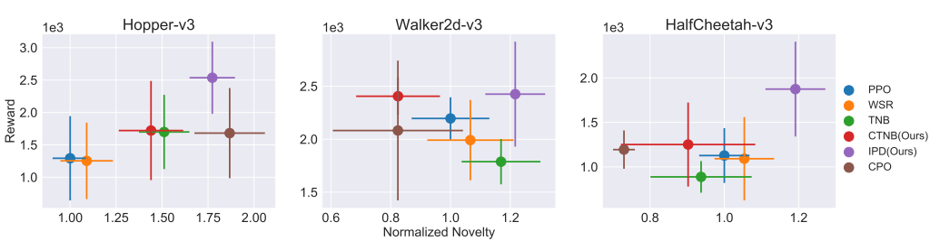
NPSCO
Novel Policy Seeking with Constrained Optimization
Our contributions:
Propose a novelty metric and practically efficient method to measure novelty of policies. (Previous work: heuristics approximation with NN)
The Constrained Optimization formulation helps improve the final performance of learned novel policies: our methods can get novel and well-performing policies

Slide 20
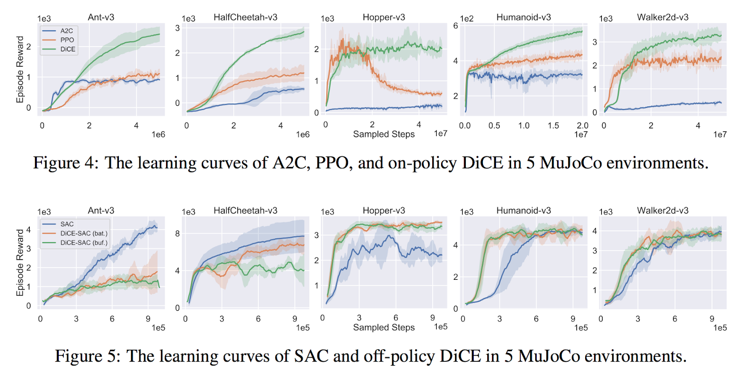
Down Stream Task: DiCE
Diversity Regularized Cooperative Exploration (DiCE)
DiCE can work with both PPO and SAC to boost exploration
PPO
SAC

Slide 21
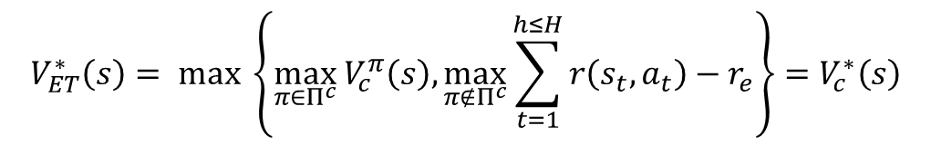
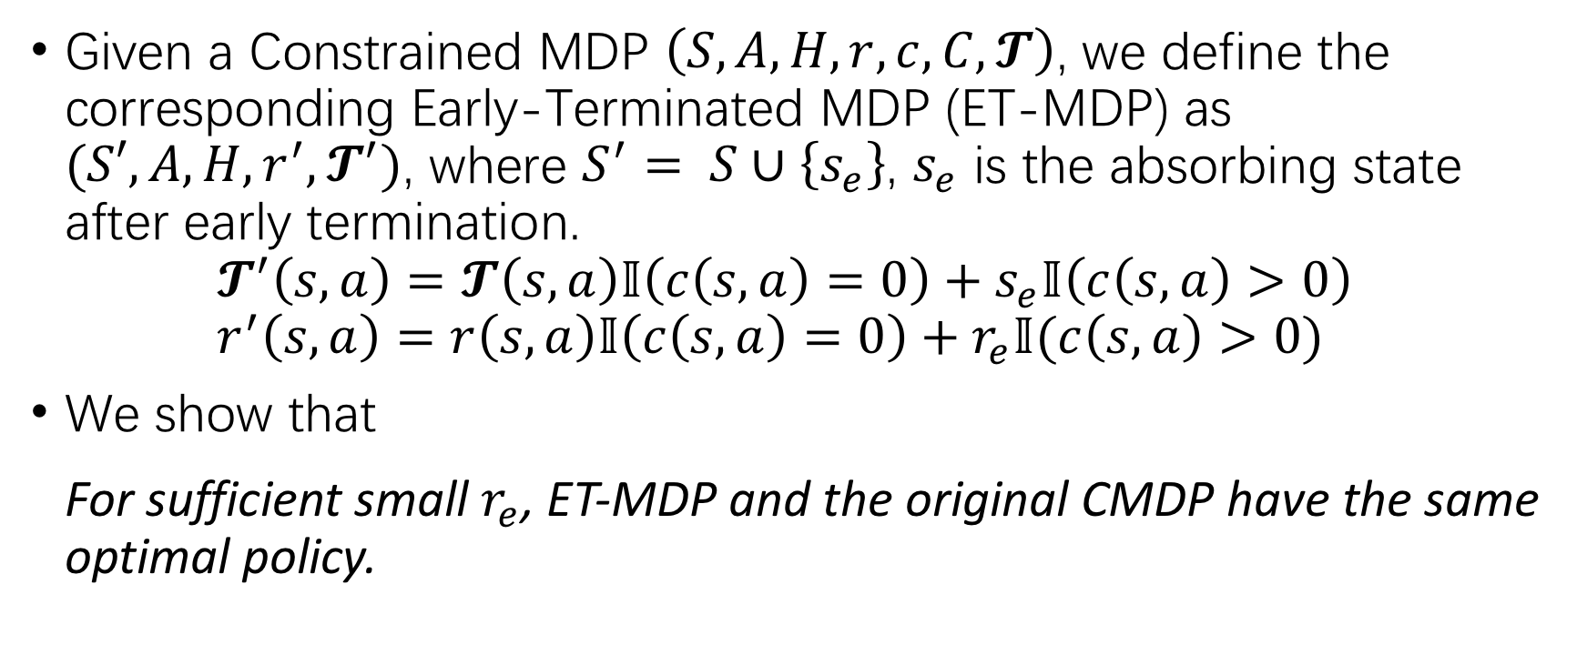
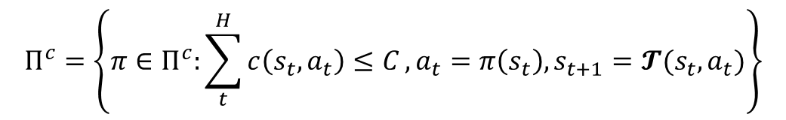
ET-MDP (Preliminary Work)
Given a Constrained MDP $\left(S,A,H,r,c,C,𝓣\right)$, we define the corresponding Early-Terminated MDP (ET-MDP) as $(S′,A,H,r^{′},𝓣^{′})$, where $S^{′}= S∪\left\{s_{e}\right\}$, $s_{e}$ is the absorbing state after early termination. $𝓣^{′}\left(s,a\right)=𝓣\left(s,a\right)𝕀\left(c\left(s,a\right)=0\right)+s_{e}𝕀\left(c\left(s,a\right)>0\right)$ $r^{′}\left(s,a\right)=r\left(s,a\right)𝕀\left(c\left(s,a\right)=0\right)+r_{e}𝕀(c\left(s,a\right)>0)$
We show that For sufficient small $r_{e}$, ET-MDP and the original CMDP have the same optimal policy.
$$Π^{c}=\left\{π∈Π^{c}:\sum_{t}^{H}{c\left(s_{t},a_{t}\right)≤C}, a_{t}=π\left(s_{t}\right),s_{t+1}=𝓣(s_{t},a_{t})\right\}$$
$$V_{ET}^{∗}\left(s\right)= max \left\{\max_{π∈Π^{c}} V_{c}^{π}\left(s\right),\max_{π∉Π^{c}}\sum_{t=1}^{h≤H}{r\left(s_{t},a_{t}\right)−r_{e}}\right\}=V_{c}^{∗}\left(s\right)$$

Slide 22
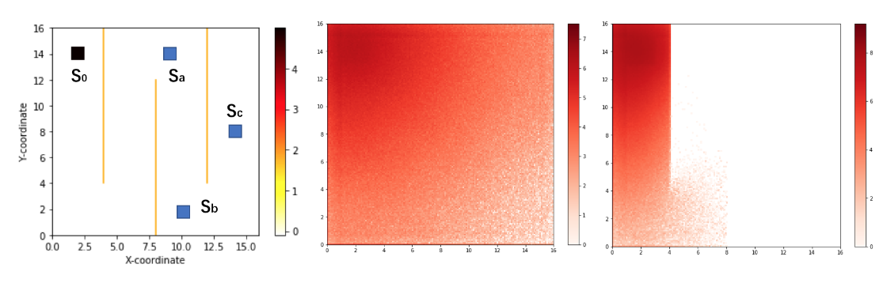
Limited State Visitation Problem
The transition connectivity of ET-MDP is poor.
The policy needs to generalize over states.
We apply Context Models in Meta-RL to facilitate generalization^{[4]}
[4] Fakoor, Rasool, et al. "Meta-q-learning." In ICLR’20.

Slide 23
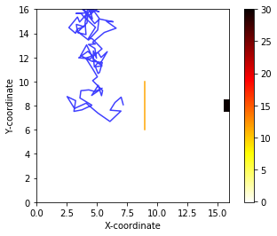
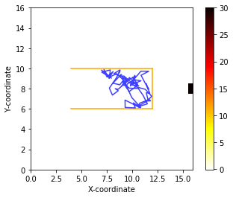
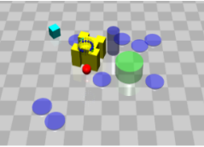
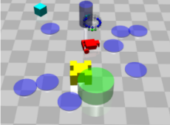
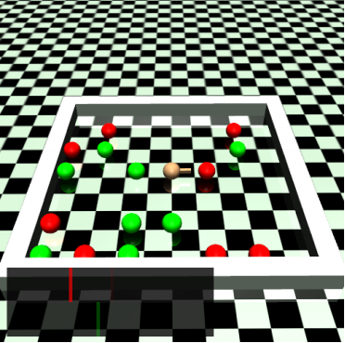
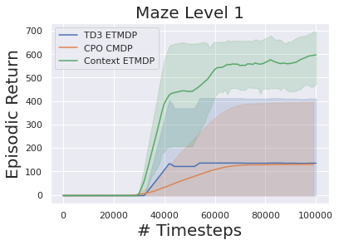
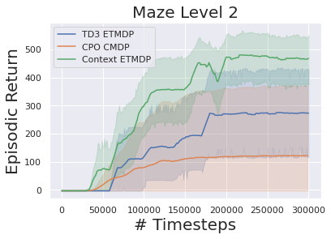
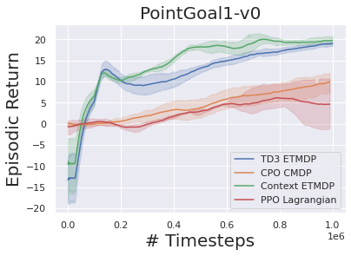
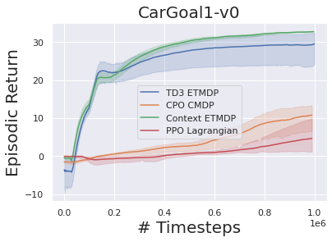
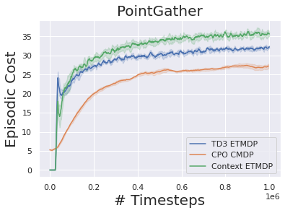
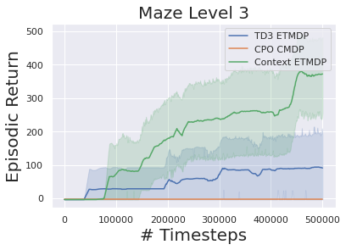
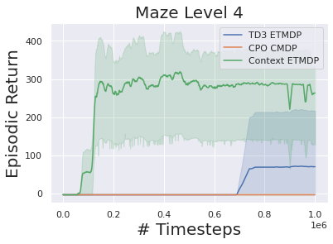
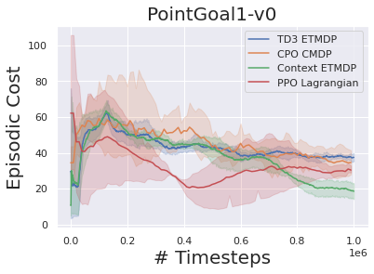
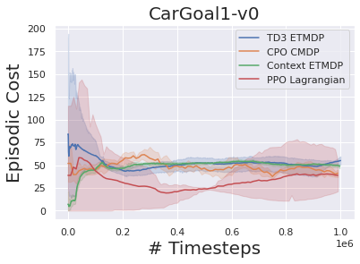
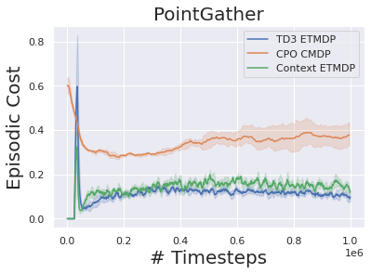
Experiments

Slide 24

Variable Selection in RL (Preliminary Work)
Motivation
Previous RL algorithms considers different dimensions of action equally important and explore with an isotropic Gaussian.
RL agents are not causal-aware
StarCraftII has 100+ dimensional action space, some of which might not be meaningful in certain states.
Human finish different tasks with different muscles.
e.g., Triathlon

Slide 25

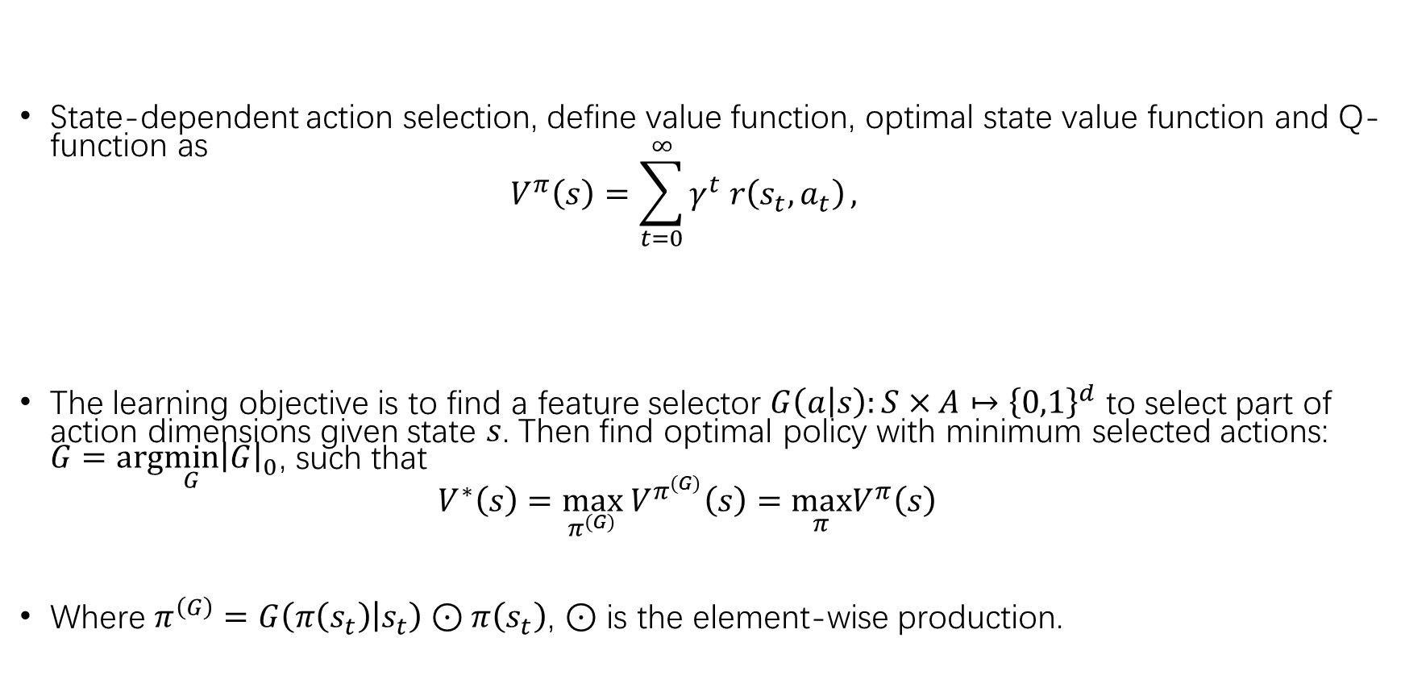
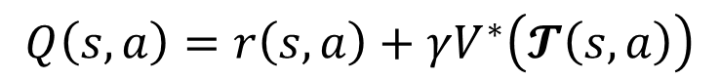
Formulation of the Problem
State-dependent action selection, define value function, optimal state value function and Q-function as $V^{π}\left(s\right)=\sum_{t=0}^{∞}{γ^{t} r\left(s_{t},a_{t}\right)},$
The learning objective is to find a feature selector $G\left(a | s\right):S×A↦{\left\{0,1\right\}}^{d}$ to select part of action dimensions given state $s$. Then find optimal policy with minimum selected actions: $G={arg\min_{G}\left|G\right|}_{0}$, such that $V^{∗}\left(s\right)=\max_{π^{\left(G\right)}} V^{π^{\left(G\right)}}\left(s\right)=\max_{π}V^{π}\left(s\right)$
Where $π^{\left(G\right)}=G\left(π\left(s_{t}\right) | s_{t}\right)⊙π\left(s_{t}\right)$, $⊙$ is the element-wise production.
$$V^{∗}\left(s\right)=\max_{π}V^{π}\left(s\right),$$
$$Q\left(s,a\right)=r\left(s,a\right)+γV^{∗}\left(𝓣\left(s,a\right)\right)$$

Slide 26
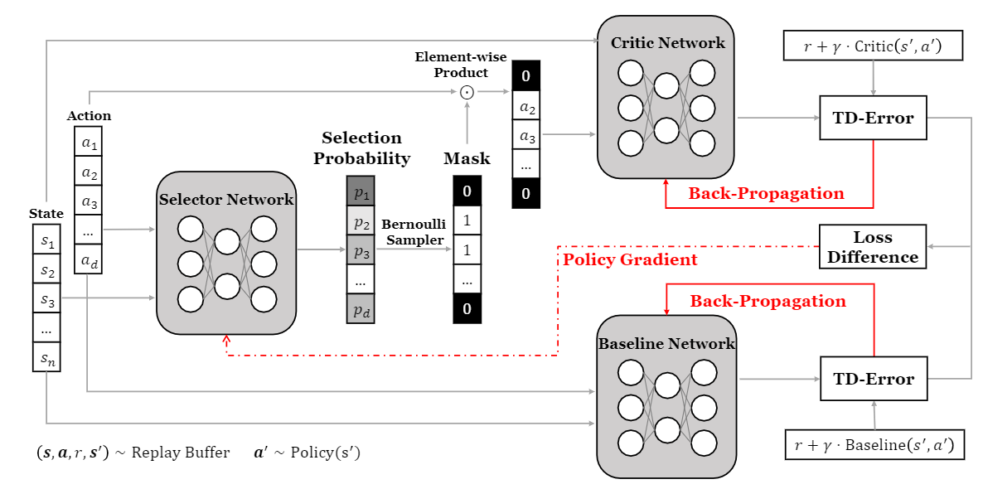
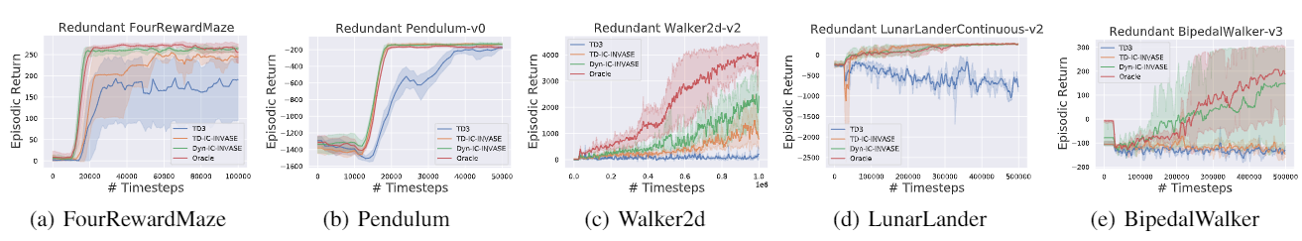
Variable Selection for Causality-Aware RL
Pipeline
Exp.

Slide 27
Thanks!
[PCHID] Sun, Hao, et al. "Policy continuation with hindsight inverse dynamics." arXiv preprint arXiv:1910.14055 (2019).
[ESPD] Sun, Hao, et al. "Evolutionary Stochastic Policy Distillation." arXiv preprint arXiv:2004.12909 (2020).
[NPSCO] Sun, Hao, et al. "Novel Policy Seeking with Constrained Optimization." arXiv preprint arXiv:2005.10696 (2020).
[ZOSPI] Sun, Hao, et al. "Zeroth-Order Supervised Policy Improvement." arXiv preprint arXiv:2006.06600 (2020).
[DiCE] Peng, Zhenghao, Hao Sun, and Bolei Zhou. "Non-local Policy Optimization via Diversity-regularized Collaborative Exploration." arXiv preprint arXiv:2006.07781 (2020).

